Slide 1
Text Properties and Languages

Slide 2
Statistical Properties of Text
How is the frequency of different words distributed?
How fast does vocabulary size grow with the size of a corpus?
Such factors affect the performance of information retrieval and can be used to select appropriate term weights and other aspects of an IR system.

Slide 3
Word Frequency
A few words are very common.
2 most frequent words (e.g. “the”, “of”) can account for about 10% of word occurrences.
Most words are very rare.
Half the words in a corpus appear only once, called hapax legomena (Greek for “read only once”)
Called a “heavy tailed” or “long tailed” distribution, since most of the probability mass is in the “tail” compared to an exponential distribution.

Slide 4
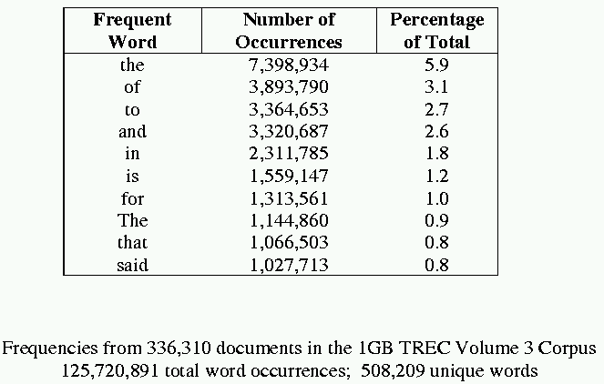
Sample Word Frequency Data (from B. Croft, UMass)

Slide 5
Zipf’s Law
Rank (r): The numerical position of a word in a list sorted by decreasing frequency (f ).
Zipf (1949) “discovered” that:
If probability of word of rank r is p_{r} and N is the total number of word occurrences:

Slide 6
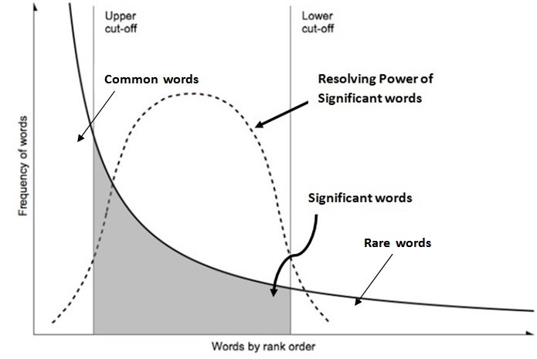
Zipf and Term Weighting
Luhn (1958) suggested that both extremely common and extremely uncommon words were not very useful for indexing.

Slide 7
Prevalence of Zipfian Laws
Many items exhibit a Zipfian distribution.
Population of cities
Wealth of individuals
Discovered by sociologist/economist Pareto in 1909
Popularity of books, movies, music, web-pages, etc.
Popularity of consumer products
Chris Anderson’s “long tail”

Slide 8
Predicting Occurrence Frequencies
By Zipf, a word appearing n times has rank r_{n}=AN/n
Several words may occur n times, assume rank r_{n} applies to the last of these.
Therefore, r_{n} words occur n or more times and r_{n+1} words occur n+1 or more times.
So, the number of words appearing exactly n times is:

Slide 9
Predicting Word Frequencies (cont)
Assume highest ranking term occurs once and therefore has rank D = AN/1
Fraction of words with frequency n is:
Fraction of words appearing only once is therefore ½.

Slide 10
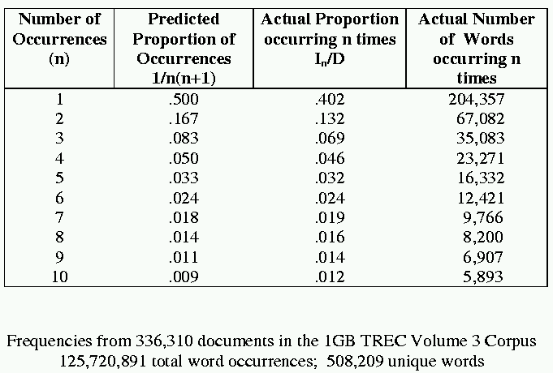
Occurrence Frequency Data (from B. Croft, UMass)

Slide 11
Does Real Data Fit Zipf’s Law?
A law of the form y = kx^{c} is called a power law.
Zipf’s law is a power law with c = –1
On a log-log plot, power laws give a straight line with slope c.
Zipf is quite accurate except for very high and low rank.

Slide 12
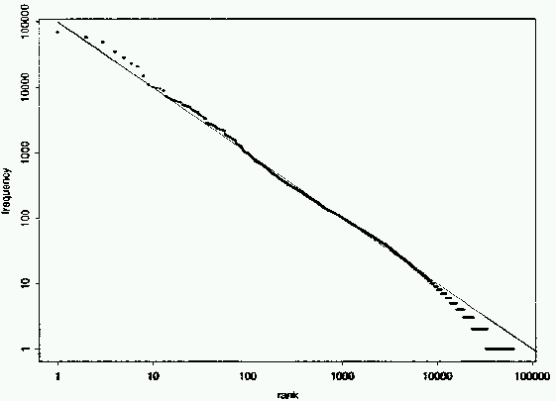
Fit to Zipf for Brown Corpus
k = 100,000

Slide 13
Mandelbrot (1954) Correction
The following more general form gives a bit better fit:

Slide 14
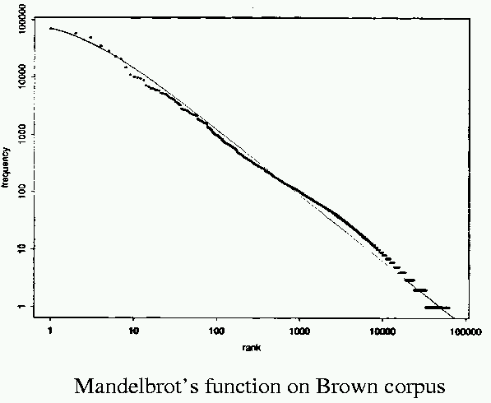
Mandelbrot Fit
P = 10^{5.4}, B = 1.15, ρ = 100

Slide 15
Explanations for Zipf’s Law
Zipf’s explanation was his “principle of least effort.” Balance between speaker’s desire for a small vocabulary and hearer’s desire for a large one.
Debate (1955-61) between Mandelbrot and H. Simon over explanation.
Simon explanation is “rich get richer.”
Li (1992) shows that just random typing of letters including a space will generate “words” with a Zipfian distribution.
Li, W. (1992). Random texts exhibit Zipf’s-law-like word frequency distribution. IEEE Transactions on InformationTheory,38(6), 1842–1845.

Slide 16
Zipf’s Law Impact on IR
Good News:
Stopwords will account for a large fraction of text so eliminating them greatly reduces inverted-index storage costs.
Postings list for most remaining words in the inverted index will be short since they are rare, making retrieval fast.
Bad News:
For most words, gathering sufficient data for meaningful statistical analysis (e.g. for correlation analysis for query expansion) is difficult since they are extremely rare.

Slide 17
Vocabulary Growth
How does the size of the overall vocabulary (number of unique words) grow with the size of the corpus?
This determines how the size of the inverted index will scale with the size of the corpus.
Vocabulary not really upper-bounded due to proper names, typos, etc.

Slide 18
Heaps’ Law
If V is the size of the vocabulary and the n is the length of the corpus in words:
Typical constants:
K ≈ 10−100
β ≈ 0.4−0.6 (approx. square-root)

Slide 19
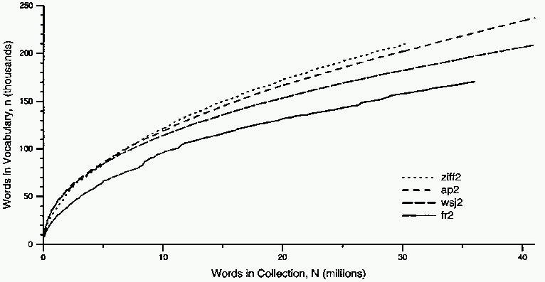
Heaps’ Law Data

Slide 20
Explanation for Heaps’ Law
Can be derived from Zipf’s law by assuming documents are generated by randomly sampling words from a Zipfian distribution.

Slide 21
Metadata
Information about a document that may not be a part of the document itself (data about data).
Descriptive metadata is external to the meaning of the document:
Author
Title
Source (book, magazine, newspaper, journal)
Date
ISBN
Publisher
Length

Slide 22
Metadata (cont)
Semantic metadata concerns the content:
Abstract
Keywords
Subject Codes
Library of Congress
Dewey Decimal
UMLS (Unified Medical Language System)
Subject terms may come from specific ontologies (hierarchical taxonomies of standardized semantic terms).

Slide 23
Web Metadata
META tag in HTML
<META NAME=“keywords” CONTENT=“pets, cats, dogs”>
META “HTTP-EQUIV” attribute allows server or browser to access information:
<META HTTP-EQUIV=“expires” CONTENT=“Tue, 01 Jan 02”>
<META HTTP-EQUIV=“creation-date” CONTENT=“23-Sep-01”>

Slide 24
Markup Languages
Language used to annotate documents with “tags” that indicate layout or semantic information.
Most document languages (Word, RTF, Latex, HTML) primarily define layout.
History of Generalized Markup Languages:
Standard
eXtensible
GML(1969)
SGML (1985)
XML (1998)
HTML (1993)
HyperText

Slide 25
Basic SGML Document Syntax
Blocks of text surrounded by start and end tags.
<tagname attribute=value attribute=value …>
</tagname>
Tagged blocks can be nested.
In HTML end tag is not always necessary, but in XML it is.

Slide 26
HTML
Developed for hypertext on the web.
<a href=“http://www.cs.utexas.edu”>
May include code such as Javascript in Dynamic HTML (DHTML).
Separates layout somewhat by using style sheets (Cascade Style Sheets, CSS).
However, primarily defines layout and formatting.

Slide 27
XML
Like SGML, a metalanguage for defining specific document languages.
Simplification of original SGML for the web promoted by WWW Consortium (W3C).
Fully separates semantic information and layout.
Provides structured data (such as a relational DB) in a document format.
Replacement for an explicit database schema.

Slide 28
XML (cont)
Allows programs to easily interpret information in a document, as opposed to HTML intended as layout language for formatting docs for human consumption.
New tags are defined as needed.
Structures can be nested arbitrarily deep.
Separate (optional) Document Type Definition (DTD) defines tags and document grammar.

Slide 29
XML Example
<person>
<name> <firstname>John</firstname>
<middlename/>
<lastname>Doe</lastname>
</name>
<age> 38 </age>
<email> jdoe@austin.rr.com</email>
</person>
<tag/> is shorthand for empty tag <tag></tag>
Tag names are case-sensitive (unlike HTML)
A tagged piece of text is called an element.

Slide 30
XML Example with Attributes
<product type=“food”>
<name language=“Spanish”>arroz con pollo</name>
<price currency=“peso”>2.30</price>
</product>
Attribute values must be strings enclosed in quotes.
For a given tag, an attribute name can only appear once.

Slide 31
XML Graph Structures
Tag “id” and “idref” attributes allows specifying graph-structured data as well as tree-structured data.
<state id=“s2”>
<abbrev> TX</abbrev>
<name>Texas</abbrev>
</state>
<city id=“c2”>
<aircode> AUS </aircode>
<name> Austin </name>
<state idref=“s2”/>
</city>

Slide 32
Document Type Definition (DTD)
Grammar or schema for defining the tags and structure of a particular document type.
Allows defining structure of a document element using a regular expression.
Expression defining an element can be recursive, allowing the expressive power of a context-free grammar.

Slide 33
DTD Example
<!DOCTYPE db [
<!ELEMENT db (person*)>
<!ELEMENT person (name,age,(parent | guardian)?>
<!ELEMENT name (#PCDATA)>
<!ELEMENT age (#PCDATA)>
<!ELEMENT parent (person)>
<!ELEMENT guardian (person)>
]>
*: 0 or more repetitions
?: 0 or 1 (optional)
| : alternation (or)
PCDATA: Parsed Character Data (may contain tags)

Slide 34
Sample Valid Document for DTD
<db>
<person>
<name> <firstname>John</firstname> <lastname>Doe</lastname>
</name>
<age> 26 </age>
<parent>
<person>
<name><firstname>Robert</firstname> <lastname>Doe</firstname>
</name>
<age> 55</age>
</person>
</parent>
</person>
</db>

Slide 35
DTD (cont)
Tag attributes are also defined:
<!ATTLIS name language CDATA #REQUIRED>
<!ATTLIS price currency CDATA #IMPLIED>
CDATA: Character data (string)
IMPLIED: Optional

Slide 36
XSL (Extensible Style-sheet Language)
Defines layout for XML documents.
Defines how to translate XML into HTML.
Define style sheet in document:
<?xml-stylesheet href=“mystyle.css” type=“text/css”>

Slide 37
Parsing XML
Process XML file into an internal data format for further processing.
SAX (Simple API for XML): Reads the flow of XML text, detecting events (e.g. tag start and end) that are sent back to the application for processing.
DOM (Document Object Model): Parses XML text into a tree-structured object-oriented data structure.

Slide 38
DOM
XML document represented as a tree of Node objects (e.g. Java objects).
Node class has subclasses:
Element
Attribute
CharacterData
Node has methods:
getParentNode()
getChildNodes()

Slide 39
Sample DOM Tree
person
Element
name
age
parent
Character-Data
firstname
lastname
26
person
John
Doe
name
age
firstname
lastname
55
Robert
Doe

Slide 40
More Node Methods
Element node
getTagName()
getAttributes()
getAttribute(String name)
CharacterData node
getData()
Also methods for adding and deleting nodes and text in the DOM tree, setting attributes, etc.

